Slide 1
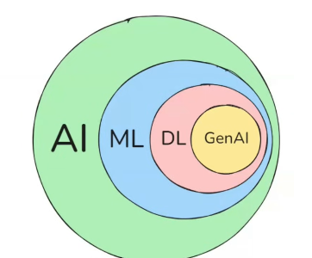

π
Langgraph
Langchain
Notes:
Content: https://www.linkedin.com/pulse/chunking-strategies-ai-data-kash-kashyap-0lghe/

Slide 2
π
What is LangChain
LangChain is an open-source library designed to simplify the process of building LLM based applications.
It provides modular building blocks that let you create sophisticated LLM-based workflows with ease.
LangChain consists of multiple components
Model components gives use a unified interface to interact with various LLM providers
Prompts component helps you engineer prompts
Retrievers component helps you fetch relevant documents from a vector store
But the biggest offering of LangChain is Chains.

Slide 3
π
What can you do with LangChain
Simple conversational workflows like Chatbot, Text Summarizers
Multistep workflows
RAG
Basic level Agents

Slide 4
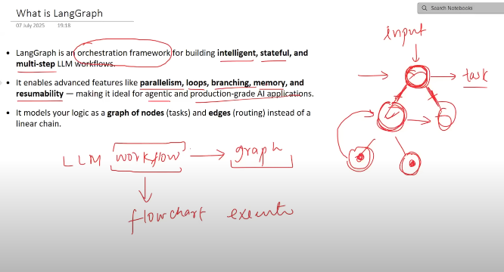
π
Notes:
Content: https://www.linkedin.com/pulse/chunking-strategies-ai-data-kash-kashyap-0lghe/

Slide 5
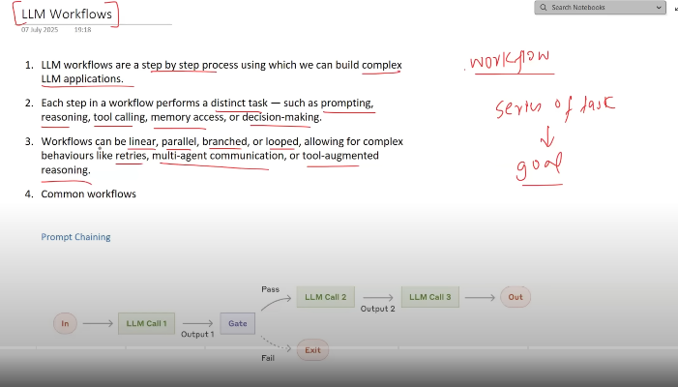
π
Workflow
a series of task that we execute in order to achieve a goal

Slide 6
π
Here each Nodes Represent a task just a python function
in Langgraph , Graph which we made it is a sets of python fun which interconnected with the help of edges
Edges just explain which node going to execute after execution of a specific node
Sequential Edges
Parallel Edges
Branching edges
Loop Edges
Notes:
Content: https://www.linkedin.com/pulse/chunking-strategies-ai-data-kash-kashyap-0lghe/

Slide 7
π
Notes:
Content: https://www.linkedin.com/pulse/chunking-strategies-ai-data-kash-kashyap-0lghe/

